Slide 1
Mission integration
Loyola's Jesuit & Catholic Mission and Identity
Claire Noonan, Teresa Calpino & Julia Pryce
January 11, 2024

Slide 2

Orienting ourselves within (Brief!) history of Jesuits
Jesuits (formally known as the Society of Jesus) were founded by St. Ignatius Loyola in 1540.
16th Century: Society of Jesus quickly recognized the importance of education in furthering their mission to serve God & society, leading to the founding of their first school in Messina, Italy in 1548.
Jesuit education rapidly expanded across Europe
  1551 established the Roman College
    model for educational principles emphasizing critical thinking, humanism, and world engagement

Slide 3
Global Reach: Jesuit education spread globally as missionaries traveled to different continents
1552--Goa, India; ongoing establishment of schools and colleagues throughout Asia, Africa, and the Americas, influencing local cultures and societies--27 in U.S., 189 worldwide
Educational Philosophy: Distinctive educational philosophy known as the "Ratio Studiorum"
Provides structured approach to education
Focus on classical studies, language, science, and moral development
Focus on developing well-rounded individuals with a strong ethical foundation
History of the founding of Loyola University Chicago, 1870 by Fr. Arnold Damen, primarily focused on serving immigrant students
IAJU map including size and scope of enrollment + alumni

Slide 4
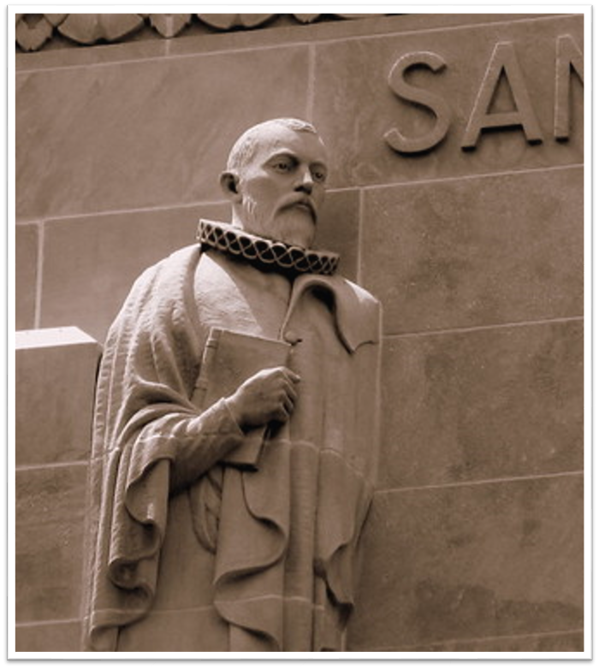
Jesuit institutions have evolved and adapted to modern educational needs over time
Have faced challenges during various historical periods, including suppression by papal decree in the late 18th century and struggles in the face of changing political landscapes and ideologies
Jesuit are a religious order within Catholic Church—Jesuits follow teachings, doctrines, traditions of Catholic Church, but have unique organizational structure and own mission and sets of practices
Ongoing effort to make significant contributions to academia, research, and service, maintaining core values while adapting to the demands of changing world.

Slide 5
LUC Mission Statement
We are Chicago's Jesuit, Catholic University - a diverse community seeking God in all things and working to expand knowledge in the service of humanity through learning, justice, and faith.

Slide 6
Core Values distinct to jesuit education
Magis (The Greater): Jesuit education emphasizes the pursuit of excellence in all aspects of life—intellectual, moral, and spiritual--encourages individuals to strive for their best and to go beyond mere academic achievement.
Cura Personalis (Care for the Whole Person): Focuses on the individual's holistic development—mind, body, and spirit (students and community)
Men and Women/People for and with Others: Instills a commitment to social justice and service to others, encouraging us to use education and talents for the betterment of society (including and at times specifically responsive toward marginalized communities)
Contemplation in Action: Rooted in Ignatian spirituality, this value encourages reflection, discernment, and contemplation as integral parts of decision-making and action. This promotes a reflective approach to life's challenges and encourages students to engage in thoughtful, meaningful action.
Finding God in All Things: Encourages individuals to seek and recognize the presence of the divine in all aspects of life, whether in academics, relationships, or societal issues—in best case, emphasizes integration of faith and reason

Slide 7

Jesuit higher education—blend of academic excellence with emphasis on ethics, social responsibility, development of whole person
--Encourages integration of intellectual growth with moral and spiritual development.
--Prizes personalized approach to education, focusing on the needs of each individual student
--Historic and ongoing emphasis on critical thinking, interdisciplinary studies, and commitment to social justice that goes beyond the classroom
--Encourages students to become ethical leaders and agents of positive change in society

Slide 8
Application of this background to your own work—choose to respond to any of these prompts:
How might this history and/or set of foundational values influence your work at Loyola now and going forward?
  Your teaching?
  Your research?
  Your service?
  Your approach to leadership and/or administration?
  What examples do you see to date of work reflecting these values, and/or opportunities provided by being a part of the larger Jesuit network?
  What challenges does Loyola face in adapting to "demands of changing world?"

Slide 9

What is discernment?
"To “discern” means to try to figure out what God wants us to do. How do we know? How do we find out? It’s not easy. "You do not need to be steeped in a religious practice or have definitions of Christian doctrine at your fingertips to practice discernment. You do need to accept a couple of principles: the sincere desire to do good and a conviction that God cares about you and your life."
-Sparough S.J. , Manney and Hipskind S.J., What's Your Decision?
"Discernment is the spiritual practice of noticing the movements within your heart and soul, identifying the thoughts, desires, and emotions that motivate them, and using these insights to decide where God is leading you." -Dychman, Garvin and Liebert, The Spiritual Exercises Reclaimed
"Discernment, first articulated by St. Ignatius Loyola, offers a paradigm for making choices, in a spiritual context, between several possibilities all of which are potentially good. It invites us to ask the question, 'What do I desire?' in the presence of a deepening relationship with God and the common good." Jesuitresource.org

Slide 10
What discernment is not
A process for choices that are absolutely clear or need to be made on a moment's notice
Is not a method to get what you want
A linear process
A guarantee of certainty

Slide 11
Three "Times" of Discernment
The First Time: Ignatius says, "Your decision comes without doubt or being able to doubt."
The Second Time: We feel conflicted when faced with an important choice. One alternative seems more attractive than the others, but we have misgivings.
  Consolation and Desolation
The Third Time: You have two good alternatives where neither seems an obvious choice
  Analysis
  Imagination

Slide 12
Five Insights From discernment
"Our one choice should be this: I want and I choose what leads to God's deepening life in me."--The Spiritual Exercises
Make discernment a priority
Spend time focused in reflection
  Awareness
Don't act impulsively
Pay attention to shifts in your emotions and inner life

Slide 13
Signs of good discernment
Leads to movement; especially along the path of love and service
Made in freedom
Feels balanced and involves the whole person (mind, will, and emotion)
Leads to more questions and into deeper knowledge

Slide 14
Using discernment
  Identify 1 goal for each of the following areas: teaching, research, service, and leadership.
  Identify 1 area of concern for each area.
  Notice how you feel when you think about these goals
  Imagine what would it feel like if you attained your goal? Write down anything significant.
  Jot down some potential advantages and disadvantages of pursuing the paths you have identified.

Slide 15
Break out groups
Share one of your goals/decisions with group.
Share your thoughts: What are some of the thoughts and emotions you discerned?
Share any significant advantages or disadvantages you noted.
=========
Listen carefully without interrupting or offering advice.
When the presenter is done sharing, each listener can offer one insight.
Don't advise or direct, instead ask a question or reflect one thing that you think is significant from the presenter's reflection.

Slide 16
Works Cited
Dyckman, Katherine, Garvin, Mary and Liebert, Elizabeth. The Spiritual Exercises Reclaimed: Uncovering Liberating Possibilities for Women. New York: Paulist Press. 2001.
Fleming, David S.J. Draw Me into Your Friendship: A Literal Translation and a Contemporary Reading of the Spiritual Exercises. Brighton, MA: Institute of Jesuit Sources. 1996.
_____________. What is Ignatian Spirituality? Chicago: Loyola Press, 2008.
Lonsdale, David. Eyes to See Ears to Hear: An Introduction to Ignatian Spirituality. New York: Orbis Books, 2000.
Sparough, J. Michael S.J., Manney, Jim and Hipskind, Tim S.J. What's Your Decision? How to Make Choices with Confidence and Clarity, An Ignatian Approach. Chicago: Loyola Press. 2010.
Tetlow, Joseph S.J. Always Discerning: An Ignatian Spirituality for the New Millenium. Chicago: Loyola Press. 2016.

Slide 17
Upcoming opportunities for further learning/engagement
IGNATIAN SPIRITUALITY
Busy Person's Retreat: Feb. 15-April 3, with weekly spiritual direction
Faculty Writing Retreat: March 4-6, Bellarmine Jesuit Reteat House, Barrington IL
May Retreat, honoring the faith, spirituality and aspirations of women of color: May 16-18, LUREC
Ignatian Contemplation Retreat: June 4-6, LUREC
HANK CENTER FOR THE CATHOLIC INTELLECTUAL HERITAGE:
Research Fellowship for advanced scholarly study of Catholic thought as it touches on the arts, humanities, and sciences: January 22 submission deadline
Course Development Grant for graduate and undergraduate courses connected to a broad range of Catholic thought: January 22 submission deadline
FACULTY CENTER FOR IGNATIAN PEDAGOGY:
January 23: Applying IP Theme "Contemplatives in Action" to Classroom Strategies with Eilene Edejer and Elizabeth Wakefield
February 27: Applying IP Theme "Accompaniment" to Classroom Strategies with Julia Pryce and Felipe Legarreta
March 26: Applying IP Theme "Cura Personalis" to Classroom Strategies with Regina Conway-Phillips and Jorgia Connor

Slide 18
Contact Information
Claire Noonan, Vice President for Mission Integration: cnoonan@luc.edu
Teresa Calpino, Lecturer, Department of Theology; Director, Faculty Mission Integration for Liberal Arts & Sciences: tcalpin@luc.edu
Julia Pryce, Professor of Social Work; Director, Faculty Mission Integration
for Professional Schools: jpryce@luc.edu

